Slide 1
Message Authentication and Hash Functions

Slide 2
Ensuring Message Integrity
Encryption allows us to secure the confidentiality of a message
We want a way to be able to ensure the integrity of a message as well
Ideally, we want to be able to know who sent a message, and whether it has been altered in transit

Slide 3
Does Encryption Satisfy This?
If an attacker intercepts an encrypted message, they can rearrange the blocks
There is no way for the recipient to know that the message order has been altered
This means an attacker could impact integrity with just encryption

Slide 4
Message Authentication Codes
We generate an “authentication tag” to append to a message being sent
The authentication tag is based on a key, K, and is defined as MAC = F(K,M)
Often, the function used with the authentication tag is some cipher like DES
The recipient can verify the message is not altered by calculating F(K,M)
The recipient can also verify the identity of the sender due to the key K

Slide 5
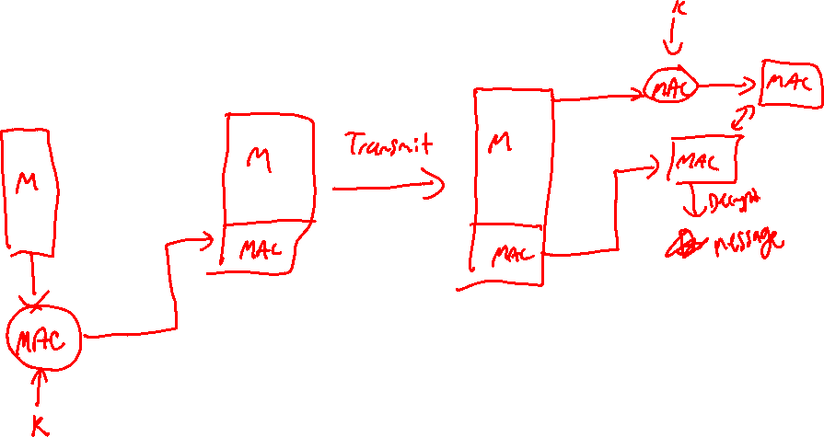
MAC Diagram

Slide 6
One-Way Hash Functions
An alternative to encryption for MAC is the usage of One-Way Hash Functions
A hash function takes a message M, and produces a unique fixed size output H(M)
Hash functions do not require a secret key, they rely on the fact that every input has a unique output

Slide 7
Advantages over Encryption
Faster than most modern encryption systems
Encryption hardware has a nonnegligible cost to implement
Encryption algorithms may be protected by a patent

Slide 8
Practical use of Hashing
If we just use hashing for message authentication, it is possible for an attacker to compromise
If the hashing function is known, the attacker can simply run their modifications through the same function
To avoid this, we use a “salt”, which is typically a key

Slide 9
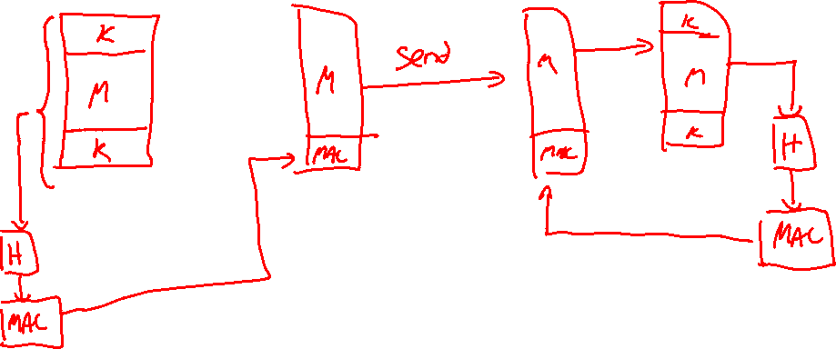
Hash Based Message Authentication

Slide 10
Hash Function Requirements
H can be applied to a block of data of any size
H produces a fixed-length output
H(x) is relatively easy to compute
It is computationally infeasible to find x such that H(x) = h
It is computationally infeasible to find y != x with H(y) = H(x)
It is computationally infeasible to find any pair (x,y) such that H(x) = H(y)

Slide 11
Hashing Algorithms
SHA was one of the first to be acceptable, however it was eventually shown to be weak
SHA1 was developed in place of SHA
SHA2 is primarily used in modern applications, and is considered secure
There is a SHA3 however it hasn’t been adapted much as of now

